Slide 1

Gotcha – A Serverless Demo App Providing Object Detection from Images
Terry Xie from Team Pineapple

Slide 2
Demo
App front end: https://gotcha-dev.ga

Slide 3
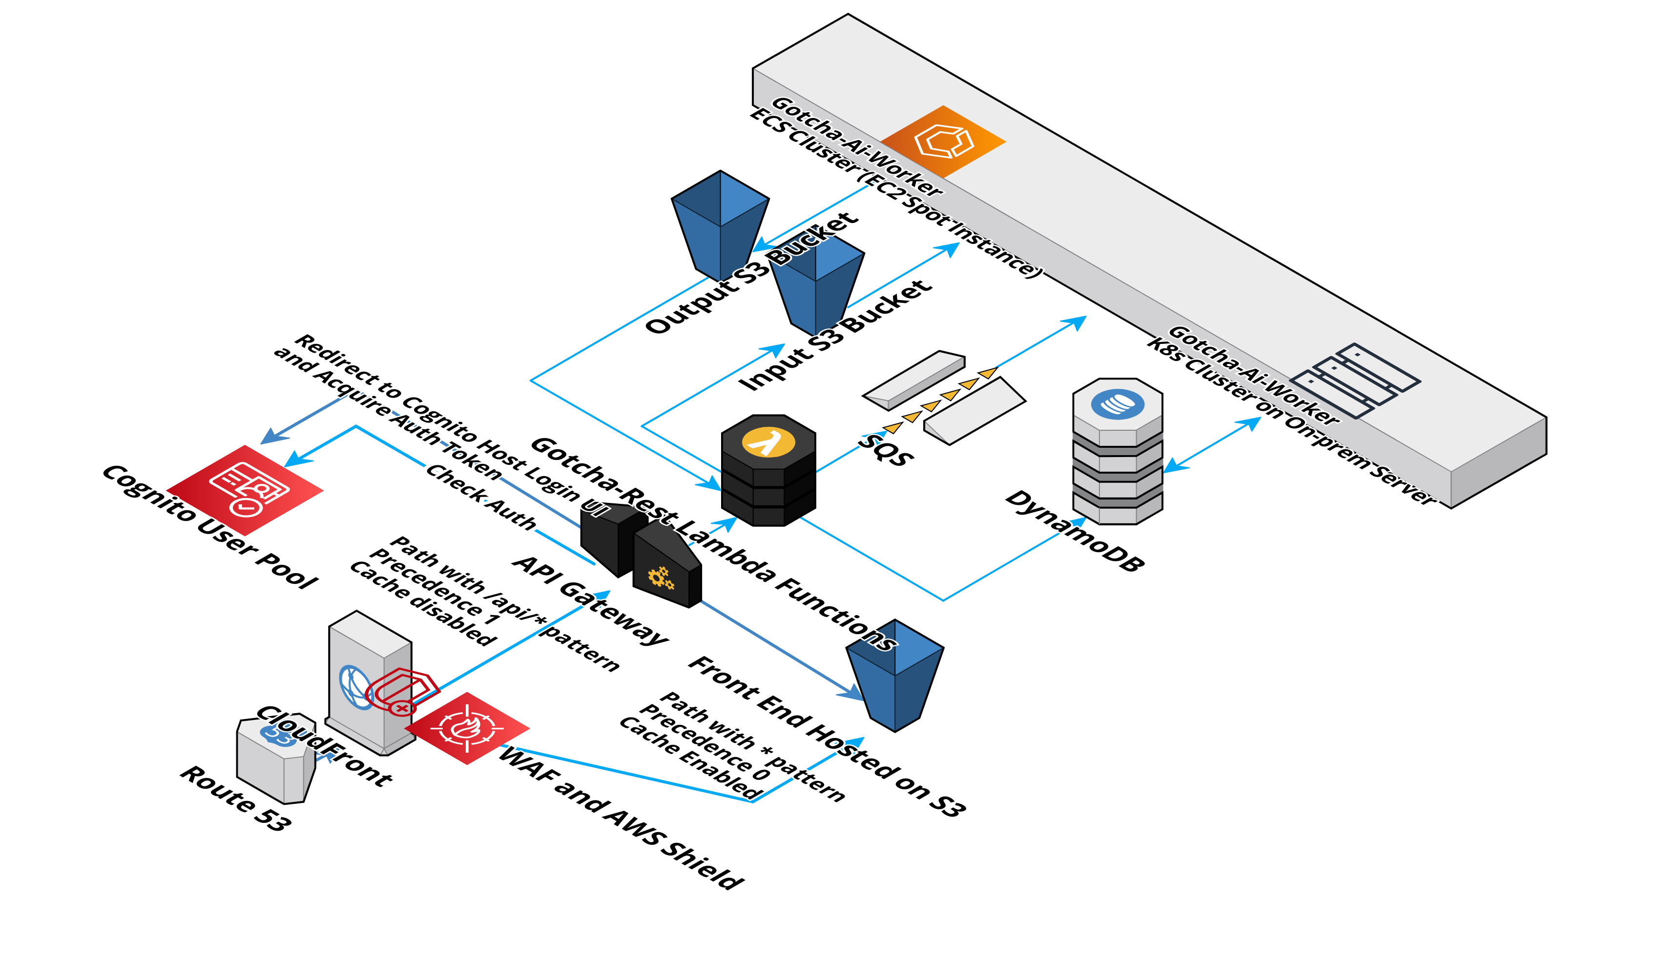
Architecture 3D

Slide 4
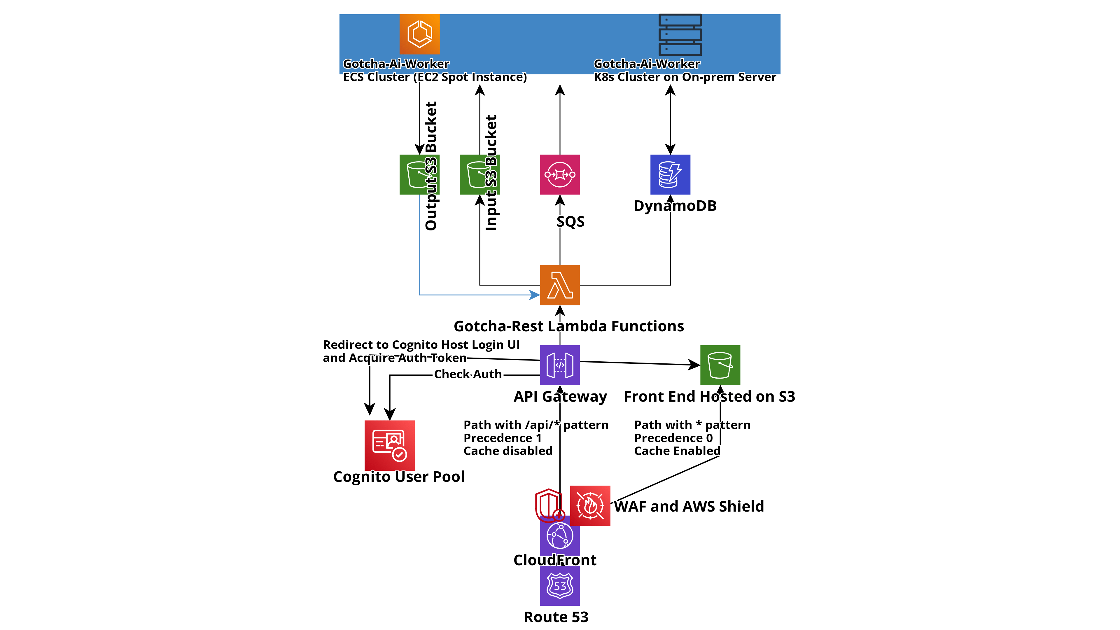
Architecture 2D

Slide 5

Cost
Route 53: 0.5$ per month for one Amazon Route 53 Hosted Zone.
AWS Lambda: 1,000,000 free requests per month with AWS free tier.
API Gateway: 1 million API calls received free per month with AWS free tier.
DynamoDB: Free 25 GB of storage and up to 200 million read/write requests per month with the AWS Free Tier.
The other services used should be free for certain quota with the AWS Free Tier too.
This Photo by Unknown author is licensed under CC BY-SA.

Slide 6
Thank You
Please feel free to make PR or ping me if you have any interests in practicing AWS services or adding more to the app!
Technologies currently used but are opened to more:
Front end:
JavaScript, React, Redux
AWS lambda functions:
NodeJs with Fastify framework
Messaging app:
Kotlin with Micronaut framework, Reactor, JMS etc.
Object detection (based on YOLO https://pjreddie.com/darknet/yolo/):
Python, Pytorch
https://github.com/liang121900/gotcha-detection-rest
https://github.com/liang121900/gotcha-ai-worker

